Slide 1
2011 ACCF/AHA/SCAI Guideline for Percutaneous Coronary Intervention
A Report of the American College of Cardiology Foundation/American Heart Association Task Force on Practice Guidelines and the Society for Cardiovascular Angiography and Interventions
© American College of Cardiology Foundation and American Heart Association, Inc.

Slide 2
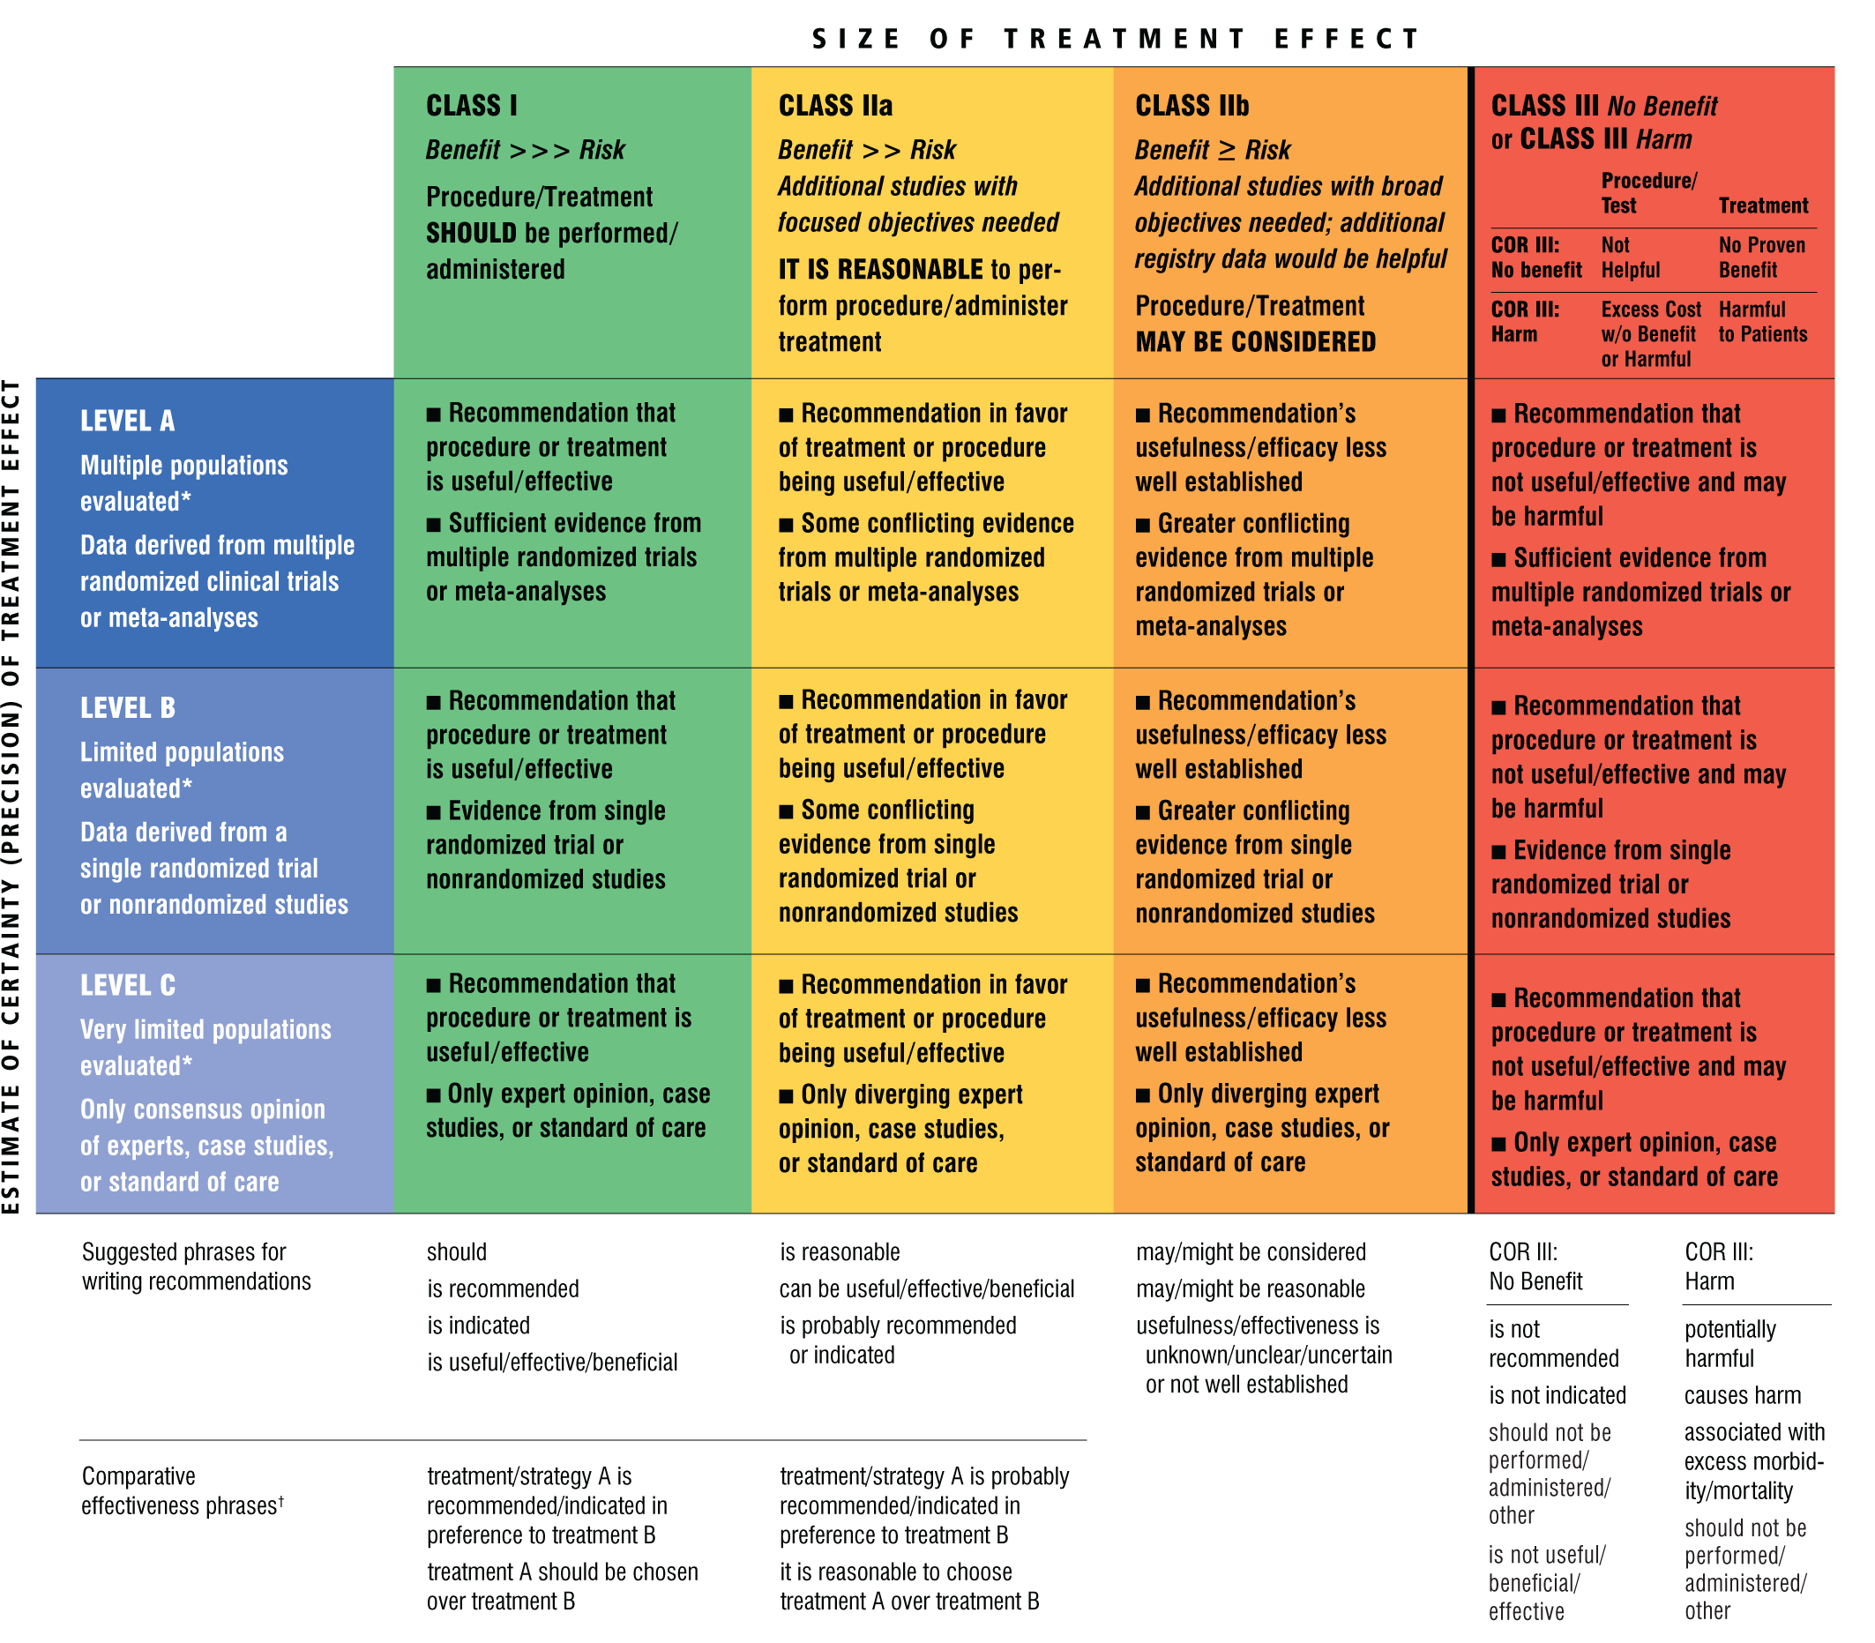
Classification of Recommendations and Levels of Evidence
A recommendation with Level of Evidence B or C does not imply that the recommendation is weak. Many important clinical questions addressed in the guidelines do not lend themselves to clinical trials. Although randomized trials are unavailable, there may be a very clear clinical consensus that a particular test or therapy is useful or effective.
*Data available from clinical trials or registries about the usefulness/ efficacy in different subpopulations, such as sex, age, history of diabetes, history of prior myocardial infarction, history of heart failure, and prior aspirin use.
†For comparative effectiveness recommendations (Class I and IIa; Level of Evidence A and B only), studies that support the use of comparator verbs should involve direct comparisons of the treatments or strategies being evaluated.

Slide 3
Introduction
The PCI guideline reflects the growth of knowledge in the field and parallels the many advances and innovations in the field of interventional cardiology, including primary PCI, BMS and DES, IVUS and physiologic assessments of stenosis, and newer antiplatelet and anticoagulant therapies. This guideline addresses ethical aspects of PCI, vascular access considerations, CAD revascularization, including hybrid revascularization, revascularization before noncardiac surgery, optical coherence tomography, advanced hemodynamic support devices, no-reflow therapies, and vascular closure devices.
Most of this document is organized according to “patient flow,” consisting of preprocedural considerations, procedural considerations, and postprocedural considerations.
The STEMI, PCI, and CABG guidelines were written concurrently, with additional collaboration with the SIHD guideline writing committee, allowing for greater collaboration on topics such as PCI in STEMI and revascularization strategies in patients with CAD.

Slide 4
Guideline for CABG
CAD Revascularization

Slide 5
CAD Revascularization
Heart Team Approach to Revascularization Decisions

Slide 6
Heart Team Approach to Revascularization Decisions
I
IIa
IIb
III
A Heart Team approach to revascularization is recommended in patients with unprotected left main or complex CAD.
Calculation of the STS and SYNTAX scores is reasonable in patients with unprotected left main and complex CAD.
I
IIa
IIb
III
B

Slide 7
CAD Revascularization
Revascularization to Improve Survival

Slide 8
Revascularization to Improve Survival: Left Main CAD Revascularization
I
IIa
IIb
III
CABG to improve survival is recommended for patients with significant (≥50% diameter stenosis) left main CAD.
PCI to improve survival is reasonable as an alternative to CABG in selected stable patients with significant (≥50% diameter stenosis) unprotected left main CAD with: 1) anatomic conditions associated with a low risk of PCI procedural complications and a high likelihood of a good long-term outcome (e.g., a low SYNTAX score [≤22], ostial or trunk left main CAD); and 2) clinical characteristics that predict a significantly increased risk of adverse surgical outcomes (e.g., STS-predicted risk of operative mortality ≥5%).
B
I
IIa
IIb
III
B
Notes:
8

Slide 9
Revascularization to Improve Survival: Left Main CAD Revascularization (cont.)
I
IIa
IIb
III
PCI to improve survival is reasonable in patients with UA/NSTEMI when an unprotected left main coronary artery is the culprit lesion and the patient is not a candidate for CABG.
PCI to improve survival is reasonable in patients with acute STEMI when an unprotected left main coronary artery is the culprit lesion, distal coronary flow is TIMI (Thrombolysis In Myocardial Infarction) grade <3, and PCI can be performed more rapidly and safely than CABG.
B
I
IIa
IIb
III
C
Notes:
9

Slide 10
Revascularization to Improve Survival: Left Main CAD Revascularization (cont.)
I
IIa
IIb
III
PCI to improve survival may be reasonable as an alternative to CABG in selected stable patients with significant (≥50% diameter stenosis) unprotected left main CAD with: 1) anatomic conditions associated with a low to intermediate risk of PCI procedural complications and an intermediate to high likelihood of good long-term outcome (e.g., low-intermediate SYNTAX score of <33, bifurcation left main CAD); and 2) clinical characteristics that predict an increased risk of adverse surgical outcomes (e.g., moderate-severe chronic obstructive pulmonary disease, disability from previous stroke, or previous cardiac surgery; STS-predicted risk of operative mortality >2%).
B
Notes:
10

Slide 11
Revascularization to Improve Survival: Left Main CAD Revascularization (cont.)
PCI to improve survival should not be performed in stable patients with significant (≥50% diameter stenosis) unprotected left main CAD who have unfavorable anatomy for PCI and who are good candidates for CABG.
I
IIa
IIb
III
B
Harm
Notes:
11

Slide 12
Revascularization to Improve Survival: Non-Left Main CAD Revascularization
I
IIa
IIb
III
CABG to improve survival is beneficial in patients with significant (≥70% diameter) stenoses in 3 major coronary arteries (with or without involvement of the proximal LAD artery) or in the proximal LAD plus 1 other major coronary artery.
B
Notes:
12

Slide 13
Revascularization to Improve Survival: Non-Left Main CAD Revascularization (cont.)
CABG
CABG or PCI to improve survival is beneficial in survivors of sudden cardiac death with presumed ischemia-mediated ventricular tachycardia caused by a significant (≥70% diameter) stenosis in a major coronary artery.
I
IIa
IIb
III
B
PCI
I
IIa
IIb
III
C
Notes:
13

Slide 14
Revascularization to Improve Survival: Non-Left Main CAD Revascularization (cont.)
CABG to improve survival is reasonable in patients with significant (≥70% diameter) stenoses in 2 major coronary arteries with severe or extensive myocardial ischemia (e.g., high-risk criteria on stress testing, abnormal intracoronary hemodynamic evaluation, or >20% perfusion defect by myocardial perfusion stress imaging) or target vessels supplying a large area of viable myocardium.
CABG to improve survival is reasonable in patients with mild-moderate left ventricular systolic dysfunction (ejection fraction 35% to 50%) and significant (≥70% diameter stenosis) multivessel CAD or proximal LAD coronary artery stenosis, when viable myocardium is present in the region of intended revascularization.
I
IIa
IIb
III
B
I
IIa
IIb
III
B
Notes:
14

Slide 15
Revascularization to Improve Survival: Non-Left Main CAD Revascularization (cont.)
I
IIa
IIb
III
CABG with a LIMA graft to improve survival is reasonable in patients with a significant (≥70% diameter) stenosis in the proximal LAD artery and evidence of extensive ischemia.
It is reasonable to choose CABG over PCI to improve survival in patients with complex 3-vessel CAD (e.g., SYNTAX score >22) with or without involvement of the proximal LAD artery who are good candidates for CABG.
B
I
IIa
IIb
III
B
Notes:
15

Slide 16
Revascularization to Improve Survival: Non-Left Main CAD Revascularization (cont.)
I
IIa
IIb
III
CABG is probably recommended in preference to PCI to improve survival in patients with multivessel CAD and diabetes mellitus, particularly if a LIMA graft can be anastomosed to the LAD artery.
The usefulness of CABG to improve survival is uncertain in patients with significant (≥70%) stenoses in 2 major coronary arteries not involving the proximal LAD artery and without extensive ischemia.
B
I
IIa
IIb
III
Notes:
16

Slide 17
Revascularization to Improve Survival: Non-Left Main CAD Revascularization (cont.)
I
IIa
IIb
III
The usefulness of PCI to improve survival is uncertain in patients with 2- or 3-vessel CAD (with or without involvement of the proximal LAD artery) or 1-vessel proximal LAD disease.
CABG might be considered with the primary or sole intent of improving survival in patients with SIHD with severe LV systolic dysfunction (EF<35%) whether or not viable myocardium is present.
The usefulness of CABG or PCI to improve survival is uncertain in patients with previous CABG and extensive anterior wall ischemia on noninvasive testing.
B
I
IIa
IIb
III
B
I
IIa
IIb
III
B
Notes:
17

Slide 18
Revascularization to Improve Survival: Non-Left Main CAD Revascularization (cont.)
I
IIa
IIb
III
CABG or PCI should not be performed with the primary or sole intent to improve survival in patients with SIHD with 1 or more coronary stenoses that are not anatomically or functionally significant (e.g., <70% diameter non−left main coronary artery stenosis, fractional flow reserve >0.80, no or only mild ischemia on noninvasive testing), involve only the left circumflex or right coronary artery, or subtend only a small area of viable myocardium.
B
Harm
Notes:
18

Slide 19
Revascularization to Improve Symptoms
I
IIa
IIb
III
CABG or PCI to improve symptoms is beneficial in patients with 1 or more significant (≥70% diameter) coronary artery stenoses amenable to revascularization and unacceptable angina despite GDMT.
CABG or PCI to improve symptoms is reasonable in patients with 1 or more significant (≥70% diameter) coronary artery stenoses and unacceptable angina for whom GDMT cannot be implemented because of medication contraindications, adverse effects, or patient preferences.
A
I
IIa
IIb
III
Notes:
19

Slide 20
Revascularization to Improve Symptoms (cont.)
PCI to improve symptoms is reasonable in patients with previous CABG, 1 or more significant (≥70% diameter) coronary artery stenoses associated with ischemia, and unacceptable angina despite GDMT.
It is reasonable to choose CABG over PCI to improve symptoms in patients with complex 3-vessel CAD (e.g., SYNTAX score >22), with or without involvement of the proximal LAD artery who are good candidates for CABG.
I
IIa
IIb
III
I
IIa
IIb
III
B
Notes:
20

Slide 21
Revascularization to Improve Symptoms (cont.)
I
IIa
IIb
III
CABG to improve symptoms might be reasonable for patients with previous CABG, 1 or more significant (≥70% diameter) coronary artery stenoses not amenable to PCI, and unacceptable angina despite GDMT.
Transmyocardial laser revascularization performed as an adjunct to CABG to improve symptoms may be reasonable in patients with viable ischemic myocardium that is perfused by arteries that are not amenable to grafting.
I
IIa
IIb
III
B
Notes:
21

Slide 22
Revascularization to Improve Symptoms (cont.)
I
IIa
IIb
III
CABG or PCI to improve symptoms should not be performed in patients who do not meet anatomic (≥50% left main or ≥70% non−left main stenosis) or physiologic (e.g., abnormal fractional flow reserve) criteria for revascularization.
I
I
I
IIa
IIa
IIa
IIa
IIb
IIb
IIb
IIb
III
III
III
III
Harm
Notes:
22

Slide 23
CAD Revascularization
Dual Antiplatelet Therapy Compliance and Stent Thrombosis

Slide 24
Dual Antiplatelet Therapy Compliance and Stent Thrombosis
PCI with coronary stenting (BMS or DES) should not be performed if the patient is not likely to be able to tolerate and comply with DAPT for the appropriate duration of treatment based on the type of stent implanted.
I
IIa
IIb
III
B
Harm
Notes:
24

Slide 25
CAD Revascularization
Hybrid Coronary Revascularization

Slide 26
Hybrid Coronary Revascularization
I
IIa
IIb
III
Hybrid coronary revascularization (defined as the planned combination of LIMA-to-LAD artery grafting and PCI of ≥1 non-LAD coronary arteries) is reasonable in patients with 1 or more of the following:
Limitations to traditional CABG, such as a heavily calcified proximal aorta or poor target vessels for CABG (but amenable to PCI);
Lack of suitable graft conduits;
Unfavorable LAD artery for PCI (i.e., excessive vessel tortuosity or chronic total occlusion).
B
Notes:
26

Slide 27
Hybrid Coronary Revascularization (cont.)
Hybrid coronary revascularization (defined as the planned combination of LIMA-to-LAD artery grafting and PCI of ≥1 non-LAD coronary arteries) may be reasonable as an alternative to multivessel PCI or CABG in an attempt to improve the overall risk-benefit ratio of the procedures.
I
IIa
IIb
III
Notes:
27

Slide 28
Preprocedural Considerations
Radiation Safety

Slide 29
Radiation Safety
Cardiac catheterization laboratories should routinely record relevant available patient procedural radiation dose data (e.g., total air kerma at the international reference point [K_{a,r}], air kerma air product [P_{KA}], fluoroscopy time, number of cine images), and should define thresholds with corresponding follow-up protocols for patients who receive a high procedural radiation dose.
I
IIa
IIb
III
Notes:
29

Slide 30
Preprocedural Considerations
Contrast-Induced Acute Kidney Injury

Slide 31
Contrast-Induced Acute Kidney Injury
I
IIa
IIb
III
Patients should be assessed for risk of contrast-induced AKI before PCI.
Patients undergoing cardiac catheterization with contrast media should receive adequate preparatory hydration.
In patients with CKD (Crcl <60 mL/min), the volume of contrast media should be minimized.
I
IIa
IIb
III
B
I
IIa
IIb
III
B
Notes:
31

Slide 32
Contrast-Induced Acute Kidney Injury (cont.)
I
IIa
IIb
III
Administration of N-acetyl-L-cysteine is not useful for the prevention of contrast-induced AKI.
A
No Benefit
Notes:
32

Slide 33
Preprocedural Considerations
Anaphylactoid Reactions

Slide 34
Anaphylactoid Reactions
Patients with prior evidence of an anaphylactoid reaction to contrast media should receive appropriate steroid and antihistamine prophylaxis before repeat contrast administration.
In patients with a prior history of allergic reactions to shellfish or seafood, anaphylactoid prophylaxis for contrast reaction is not beneficial.
I
IIa
IIb
III
B
I
IIa
IIb
III
No Benefit
Notes:
34

Slide 35
Preprocedural Considerations
Statin Treatment

Slide 36
Statin Treatment
Statin-naive patients:
I
IIa
IIb
III
Administration of a high-dose statin is reasonable before PCI to reduce the risk of periprocedural MI.
Administration of a high-dose statin is reasonable before PCI to reduce the risk of periprocedural MI.
A
Patients on chronic statin therapy:
I
IIa
IIb
III
B
Notes:
36

Slide 37
Preprocedural Considerations
Bleeding Risk

Slide 38
Bleeding Risk
I
IIa
IIb
III
All patients should be evaluated for risk of bleeding before PCI.
Notes:
38

Slide 39
Preprocedural Considerations
PCI in Hospitals Without On-Site Surgical Backup

Slide 40
PCI in Hospitals Without On-Site Surgical Backup
Primary PCI is reasonable in hospitals without on-site cardiac surgery, provided that appropriate planning for program development has been accomplished.
Elective PCI might be considered in hospitals without on-site cardiac surgery, provided that appropriate planning for program development has been accomplished and rigorous clinical and angiographic criteria are used for proper patient selection.
I
IIa
IIb
III
B
PCI in Hosptals Without On-Site Surgical Backup
I
IIa
IIb
III
B
Notes:
40

Slide 41
PCI in Hospitals Without On-Site Surgical Backup (cont.)
Primary or elective PCI should not be performed in hospitals without on-site cardiac surgery capabilities without a proven plan for rapid transport to a cardiac surgery operating room in a nearby hospital or without appropriate hemodynamic support capabilities for transfer.
I
IIa
IIb
III
PCI inHosptals Without On-Site Surgical Backup
Harm
Notes:
41

Slide 42
Procedural Considerations
Vascular Access

Slide 43
Vascular Access
I
IIa
IIb
III
The use of radial artery access can be useful to decrease access site complications.
PCI inHosptals Without On-Site Surgical Backup
A
Notes:
43

